Slide 1
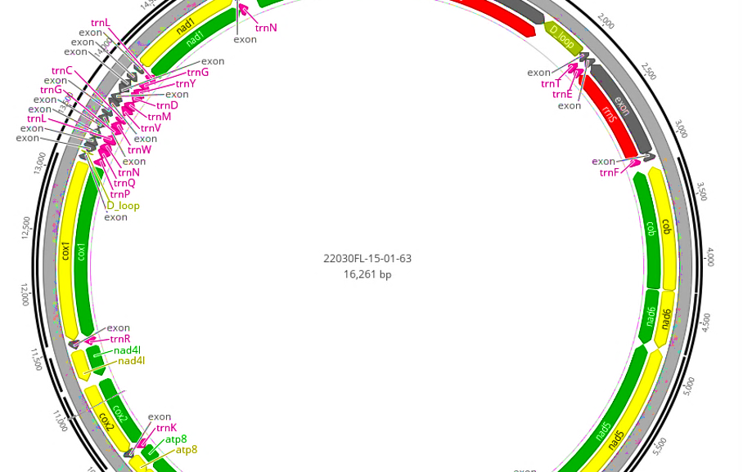


MitoPilot Overview
Dan MacGuigan
NOAA National Systematics Lab

Slide 2



What is MitoPilot?
A software package for mitogenome assembly and annotation from Illumina genome skimming data
Initial development by Devin Leopold at Jonah Ventures
Dan MacGuigan (NOAA National Systematics Lab) is leading further development and NMNH implementation
Why do we need MitoPilot?
Parallelization of mitogenome assembly and annotation
Curate and format annotation results to streamline GenBank submission
Simplify execution across multiple computing environments
Provide project management tools
Improve reproducibility of analyses
Single analysis platform for a broad range of taxa

Slide 3


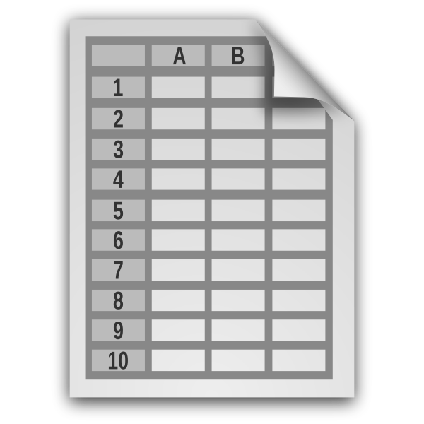
MitoPilot pipeline overview
DNA sequence data
ASSEMBLE
ANNOTATE
EXPORT
QC sequence data
Assemble mitogenome
Map reads to assembly
Identify gene regions
Automatic and manual curation
Flag problematic samples/annotations
Group samples
Create sequence FASTA files
Generate GenBank submission files
Submit to GenBank
User-generated mitogenomes (optional)
>Sample1
ATCCTTTACTGACTGACCCCCTTATCG
circular mitogenome
genes
> Sample1 NAD1
ATGACTTCTAATCTCCTTACTCACCTA
Sample metadata
fastp, GetOrganelle, MitoFinder, bowtie2
tRNAscan-SE, MITOS2
>Feature Sample1
2729 3709 gene
gene nad1

Slide 4

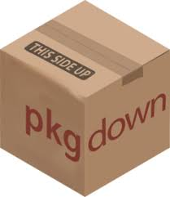





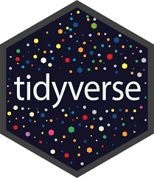



MitoPilot architecture
https://github.com/Smithsonian/MitoPilot
Code management and documentation
Dependency management
Pipeline orchestration
HPC clusters
(SI Hydra)
AWS batch
Multiple compute
environments
Database management
Project management and user interface
Local

Slide 5
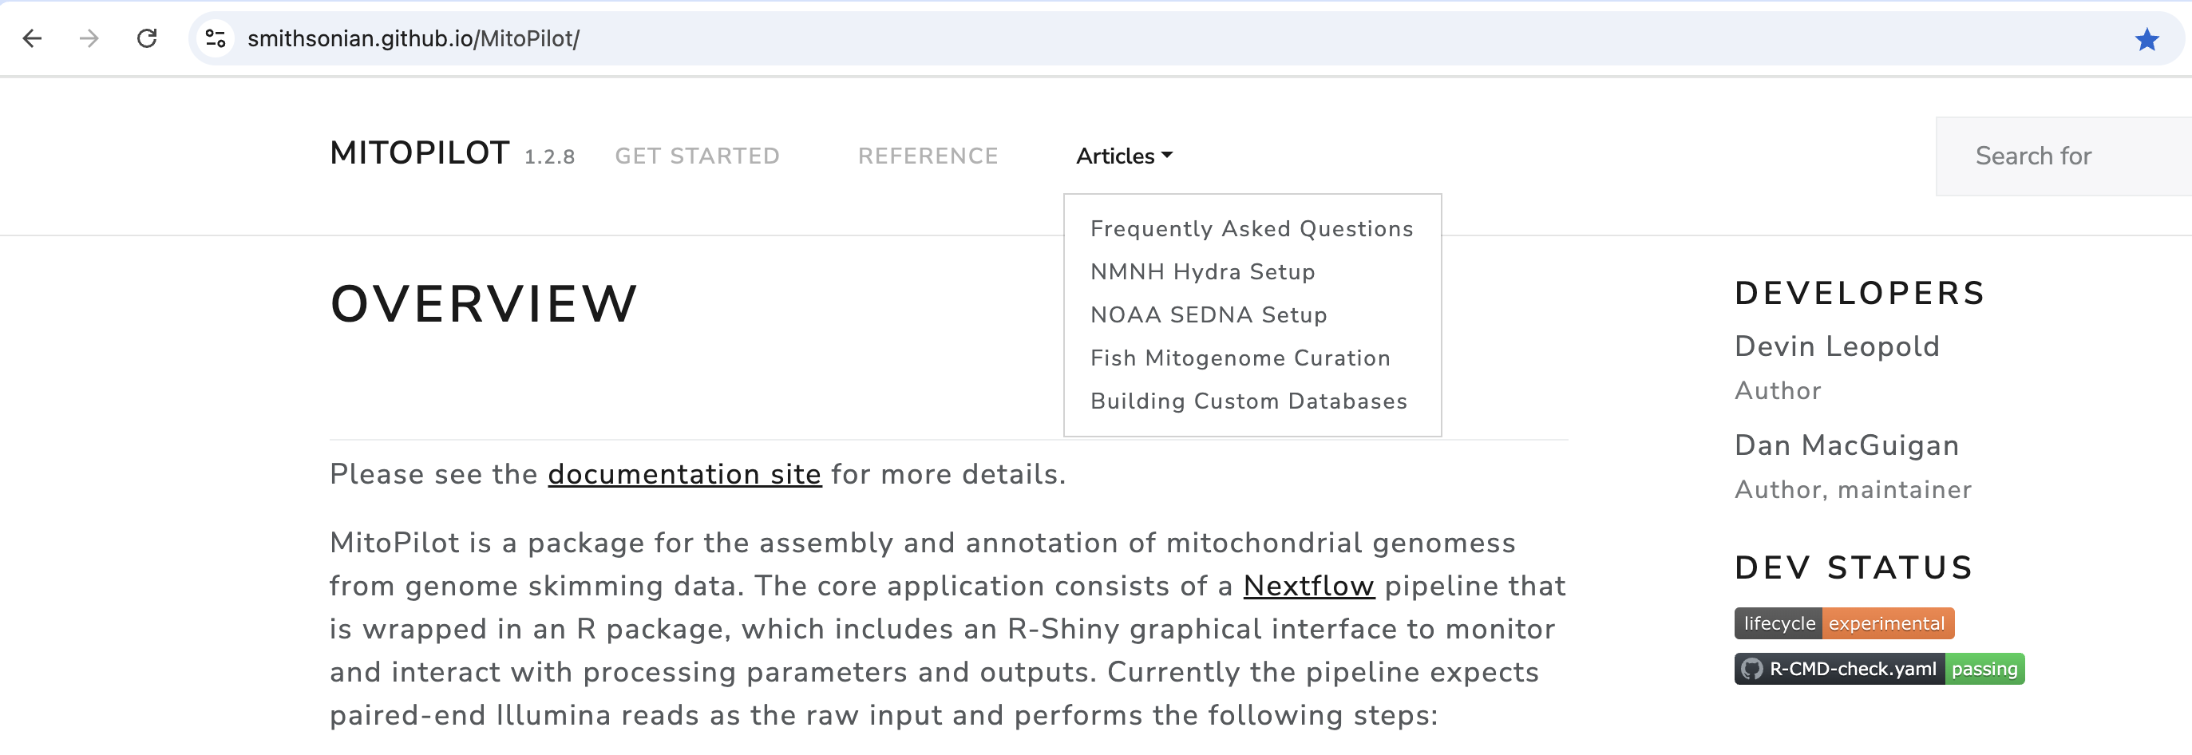
MitoPilot documentation website
Test project tutorial
Documentation for all R functions
Instructions for using MitoPilot on Hydra
https://smithsonian.github.io/MitoPilot/

Slide 6
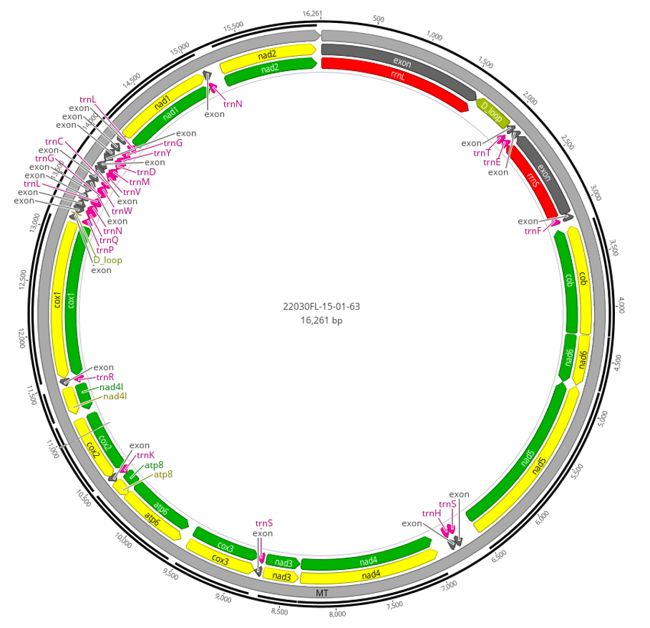
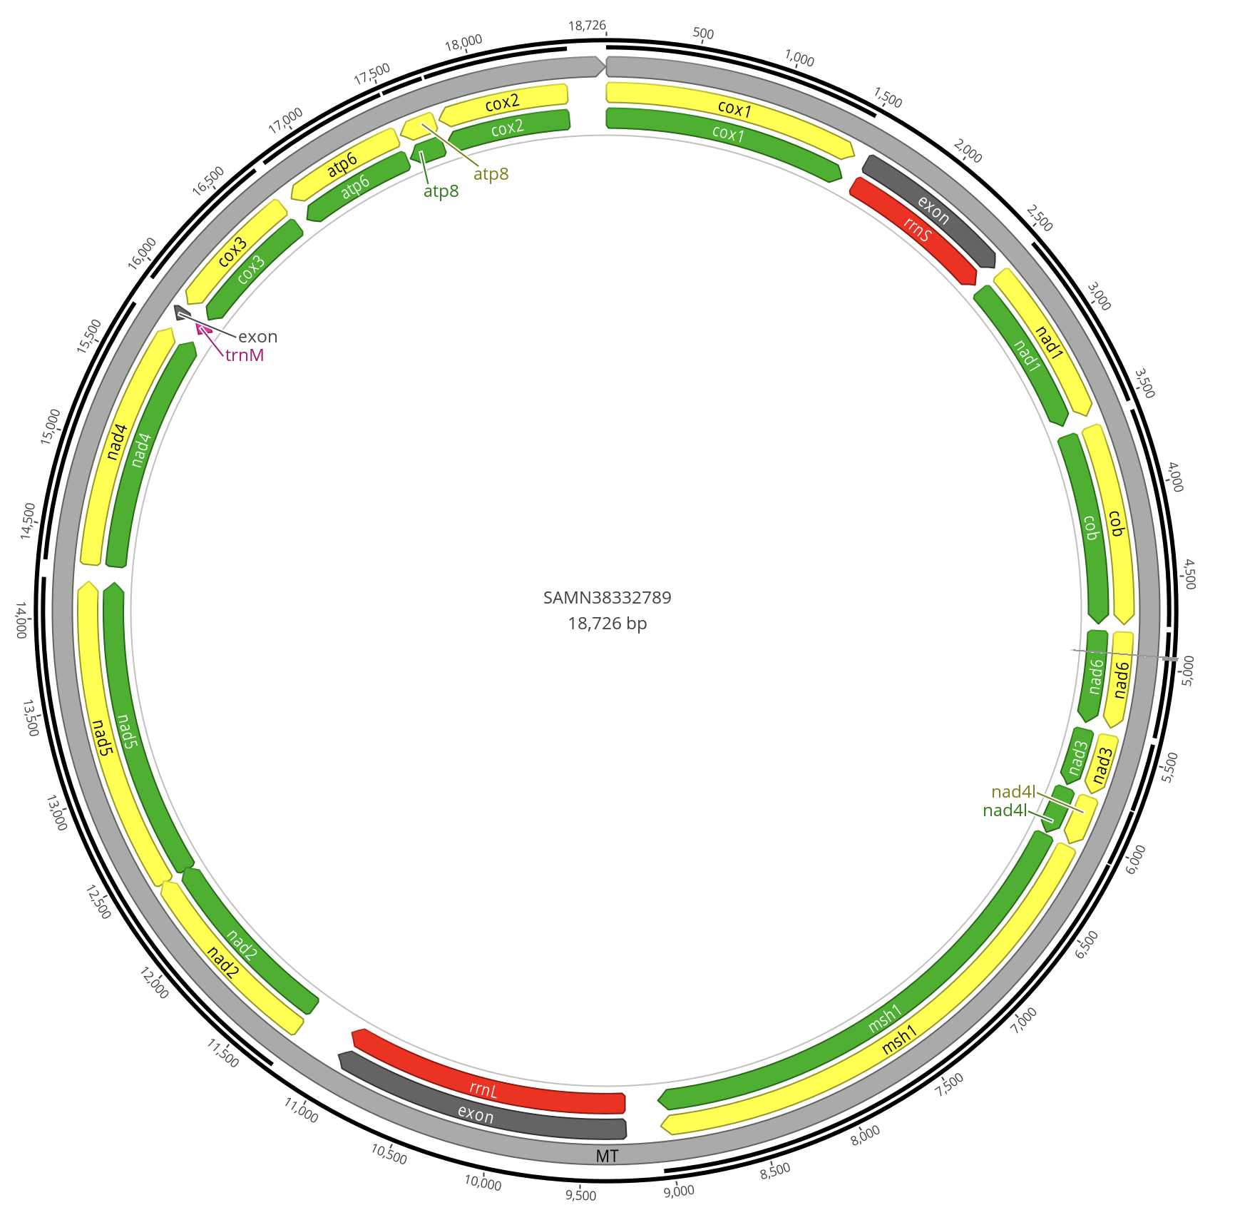
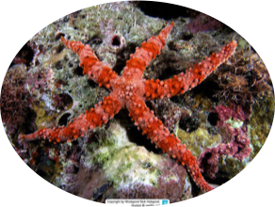
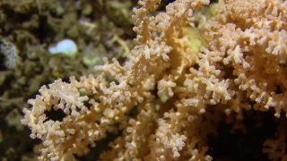
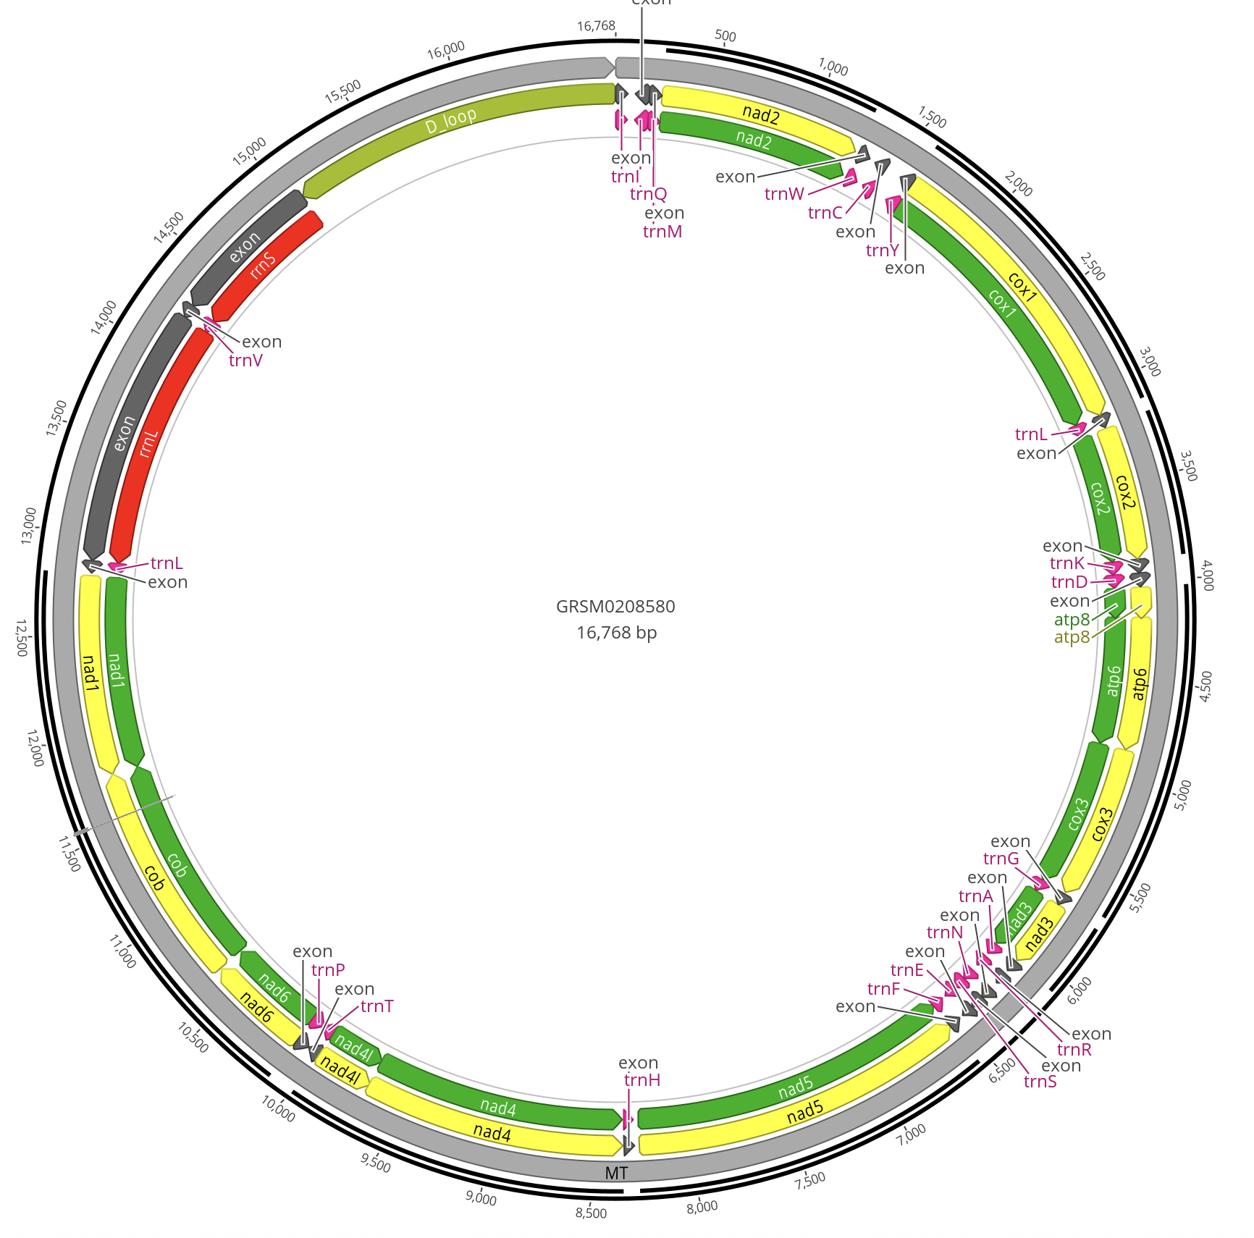
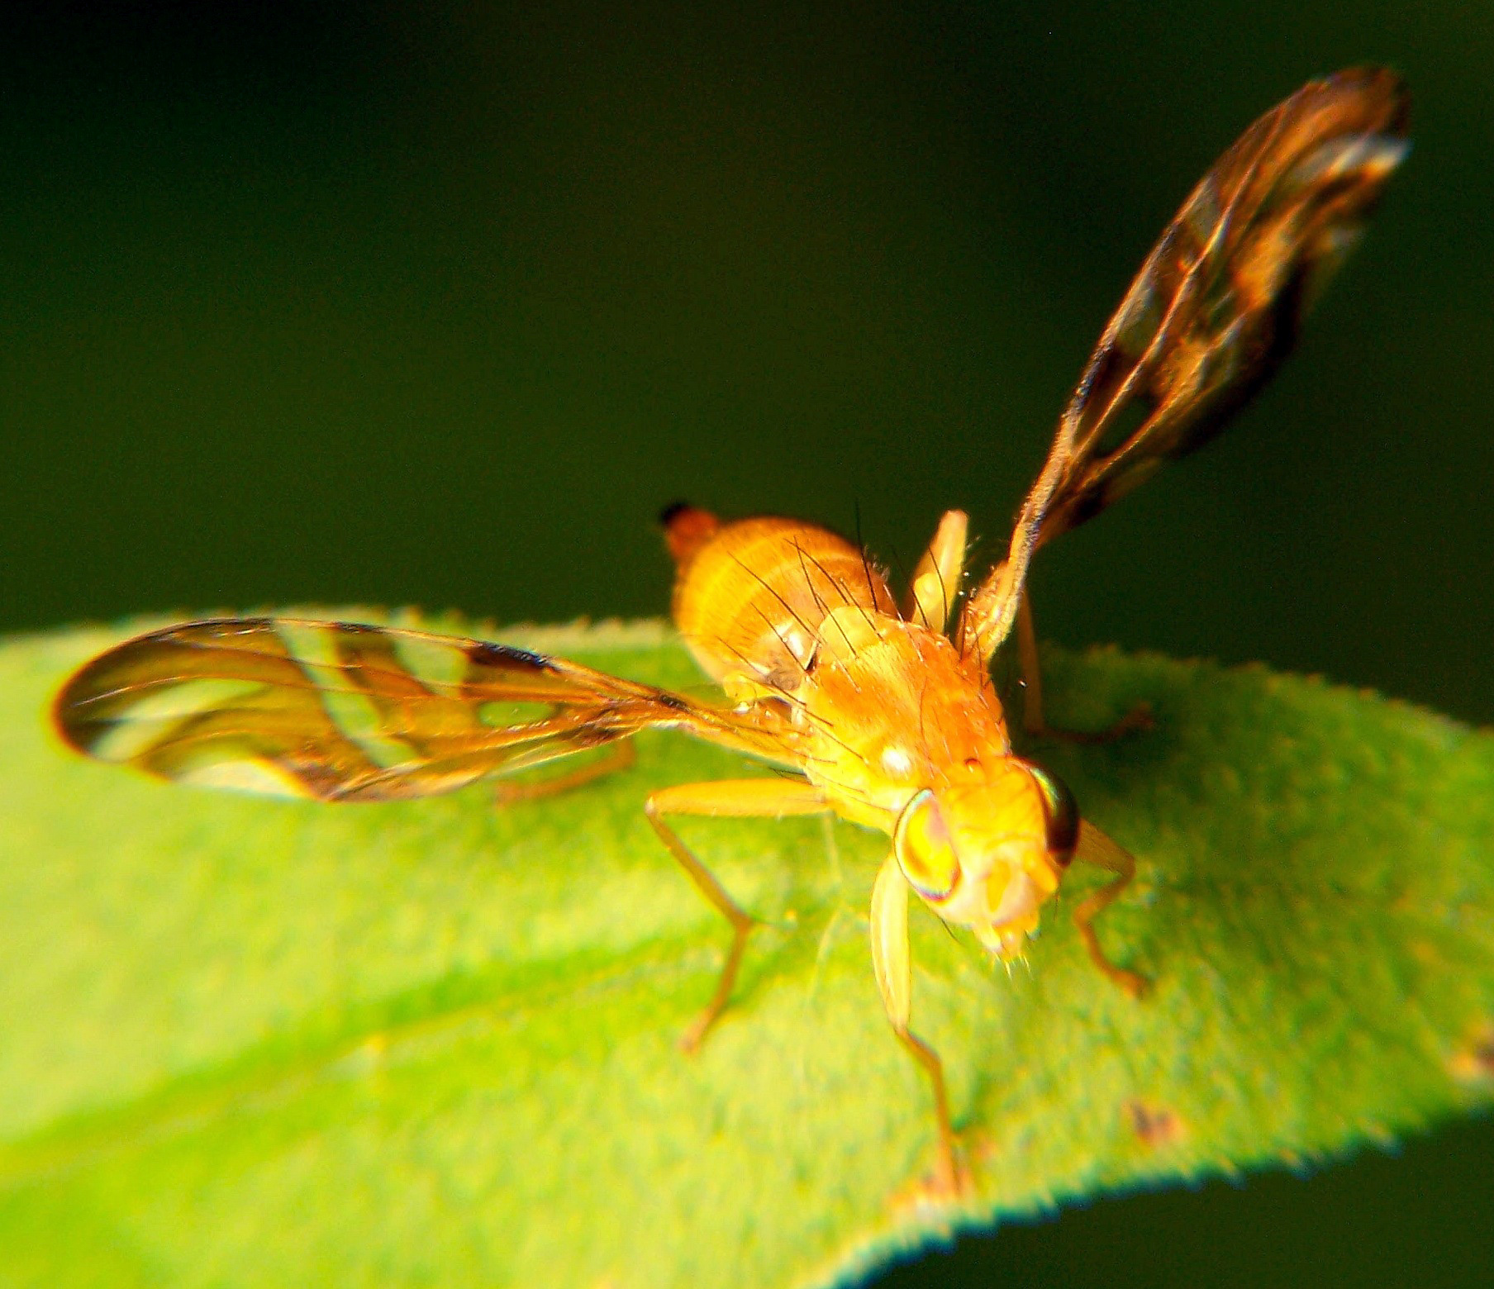
MitoPilot usage at the NMNH so far…
Tephritid fruit flies
(Strauzia rugosum)
Starfish
(Gomophia nardoa)
Octocorals
(Lateothela grandiflora)

Slide 7
Challenges ahead
Some taxa lack reference mitochondrial genomes, which makes assembly difficult
Taxa with unusual mitogenome features
Fragmented
Mitochondrial telomeres
Gene duplication
Pseudogenes
Bi-parental inheritance
NCBI GenBank has an opaque, taxon-specific review processes

